Slide 1


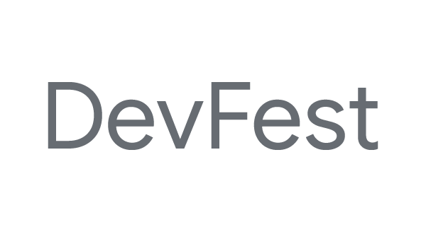

Hyderabad
Code Lab: Farm Yield Prediction
using TensorFlow on Google Colab.
Ankita Mehta, FactSet Systems India Pvt. Ltd.
Twitter: @ankitameht

Slide 2
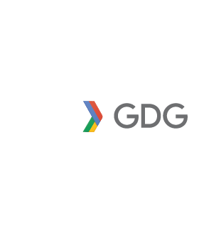
Hyderabad
What is in it for me?

Slide 3
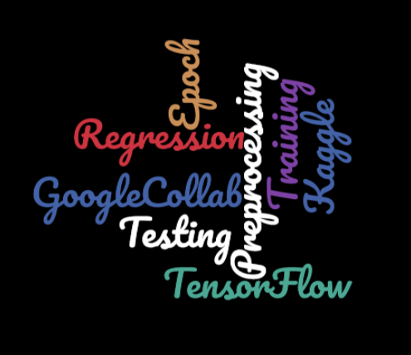
Agenda
Identifying a Regression problem
Analyzing Farm Yield Dataset
Pre-processing the Dataset
TensorFlow: A brief
Building an ML model, predicting and evaluating
Running on Locally/Google Colab
Making submission file for Kaggle
Conclusion

Slide 4
Regression
A statistical process of estimating the relationships among variables.
It measures the relationship between a dependent variable and one or more independent variables (or ‘predictors’).
Y = f(X, β)
dependent
independent

Slide 5
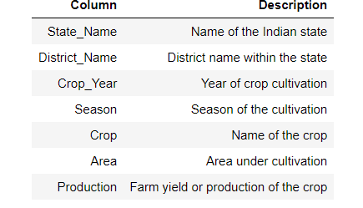
Farm Yield Dataset

Slide 6
Analyzing Dataset
Contains few numerical and few categorical features.
Target label: Production/Yield is continuous feature.

Slide 7
Pre-processing the Dataset
Identify a feature to start with.
Dealing with non-numeric data.
Building training, validation and test set.

Slide 8

TensorFlow: A brief
Open Source Machine Learning Library
Especially useful for Deep Learning
For research and production
Apache 2.0 License
Source: Basics of TensorFlow - TF Workshop - Session 1

Slide 9
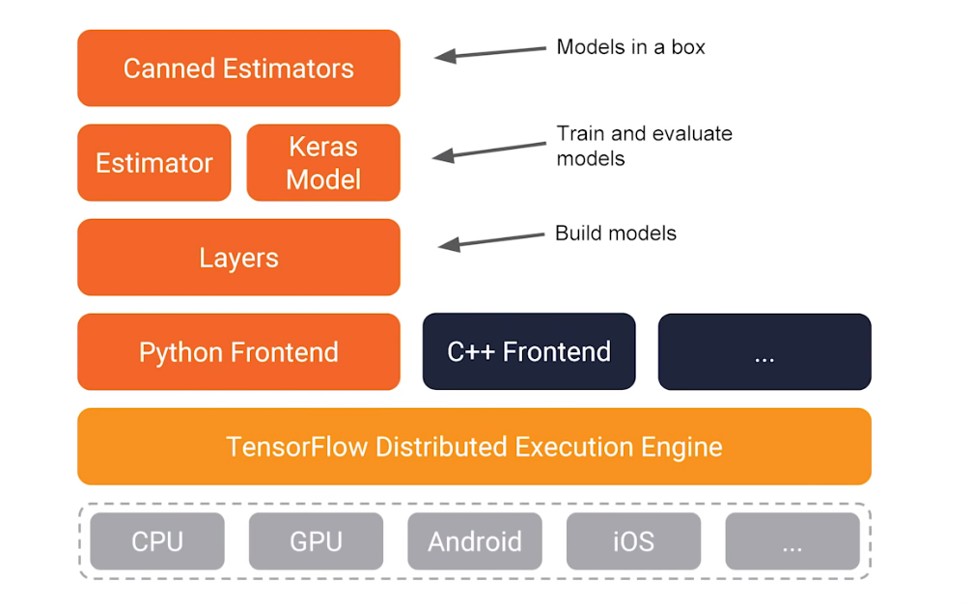
TensorFlow
Tensor: Multi-Dimensional array
Flow: A graph of operations
Nodes in the graphs: operations
Edges: Tensors (multi-dimensional array)
Tensors flow into operations
F(x)
X1
X2
X3
Y
Details: http://playground.tensorflow.org

Slide 10
Running on Locally/Google Colab
https://colab.research.google.com

Slide 11
Thank-you!
Explore the data set and include more features.

